Slide 1
A NOVEL LOCAL PATTERN DESCRIPTOR-LOCAL VECTOR PATTERN IN HIGH-ORDER DERIVATIVE SPACE FOR FACE EXPRESSION RECOGNITION
GUIDED BY
DR. A .SRI KRISHNA
Deepak Kanuri [Y13IT822]
Sahithi Kilaru [Y13IT851]
Ramya Karumanchi [Y13IT844]

Slide 2
PROBLEM STATEMENT
Face recognition attracts extensive attention recently in real-world applications . In the scope of face recognition, it is admitted that face feature description significantly affects the recognition performance. More specifically, The three critical issues for developing a good face descriptor are:
maximize the margin between inter-person
minimize the correlation between intra-person, and
(3) can be extracted with low computational cost from original input data.

Slide 3
Applications for Face Recognition
Access control
Security
Image DB investigations
General identify verifications
surveillance

Slide 5
ALGORITHM FOR LBP
EXISTING SYSTEMS
1-Divide the examined window into cells (e.g. 3X3 pixels for each cell).
2- For each pixel in a cell, compare the pixel to each of its 8 neighbors (on its left-top, left-middle, left-bottom, right-top, etc.). Follow the pixels along a circle, i.e. clockwise or counter-clockwise.
3- Where the center pixel's value is greater than the neighbor's value, write "1". Otherwise, write "0". This gives an 8-digit binary number.
4- Compute the histogram, over the cell, of the frequency of each "number" occurring (i.e., each combination of which pixels are smaller and which are greater than the center).
5- Concatenate histograms of all cells. This gives the feature vector for the window.
6-Repeat above steps for other images and find difference using Euclidean distance.

Slide 6
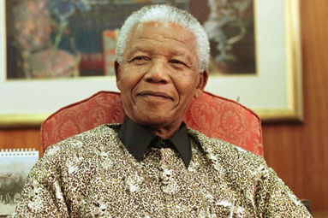
LBP

Slide 7
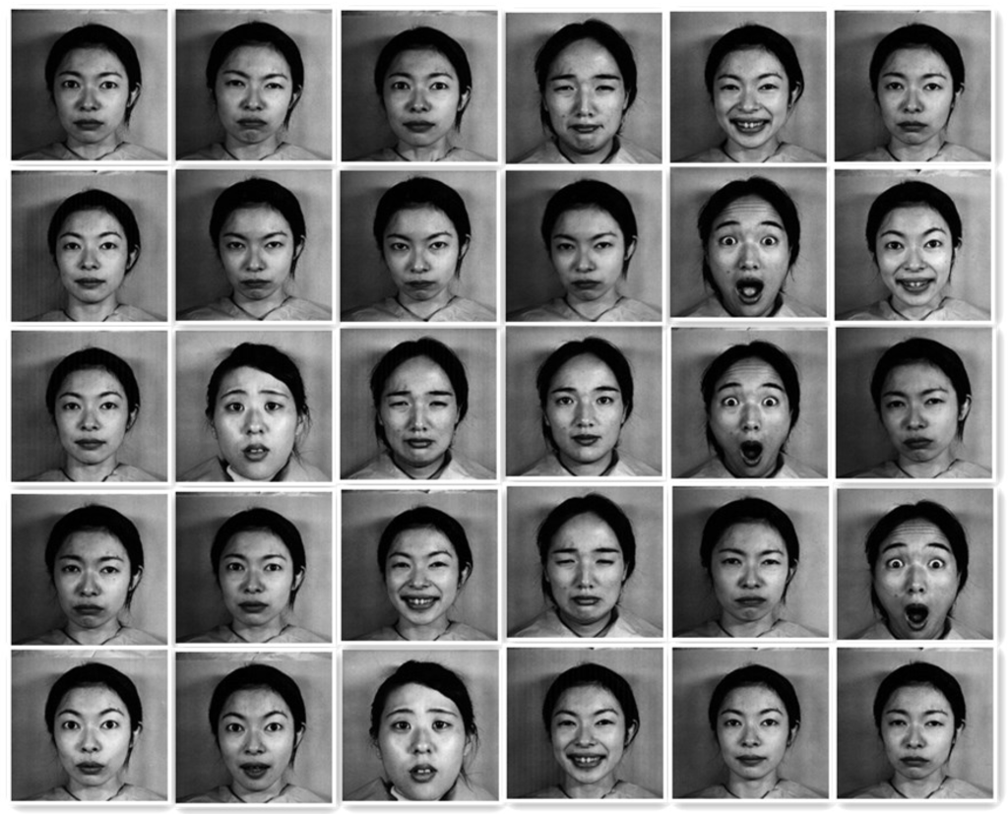
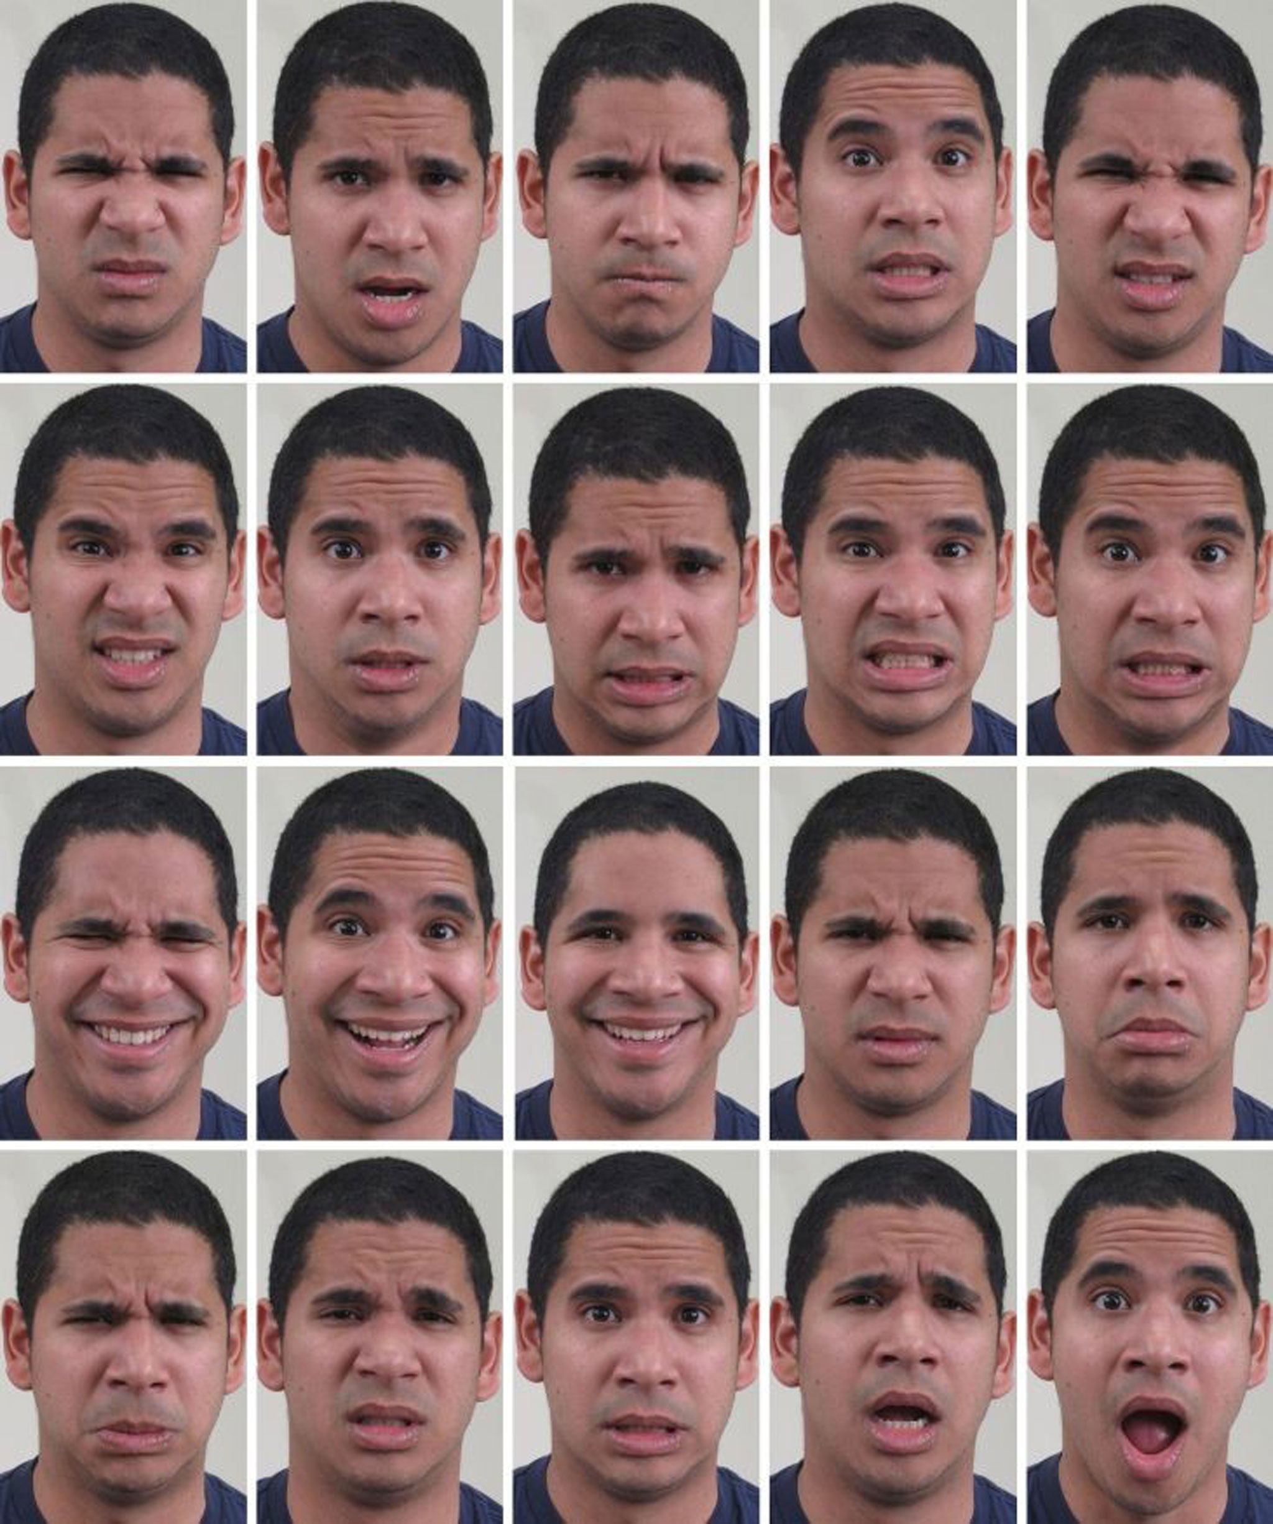
OUTPUT
B
A
Confusion matrix | A | B | Totals
A | 13 | 7 | 20
B | 7 | 23 | 30
Totals | 20 | 30 | 50

Slide 8
LOCAL DERIVATIVE PATTERN
Different from LBP encoding the relationship between the central point and its neighbors, the local derivative pattern templates extract high-order local information by encoding various distinctive spatial relationships contained in a given local region.
The high-order local derivative patterns consistently performs much better than LBP.

Slide 9
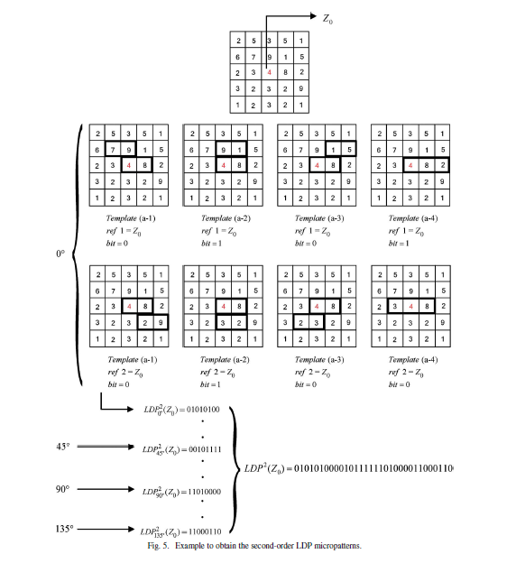
Example to obtain the second-order LDP

Slide 10
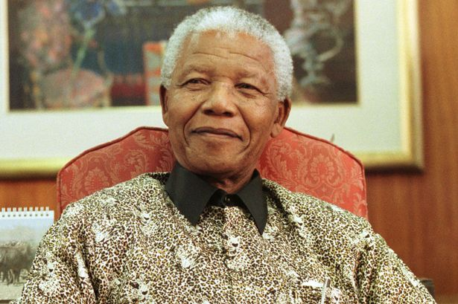
LDerP

Slide 11
Confusion Matrix | A | B | Totals
A | 17 | 3 | 20
B | 3 | 27 | 30
Totals | 20 | 30 | 50

Slide 12
Proposed work The proposed local vector pattern (LVP) in high-order derivative space is presented for use in face recognition. Based on the vector of each pixel constructed by computing the values between the referenced pixel and the adjacent pixels with diverse distances from different directions, the vector representation of the referenced pixel is generated to provide the 1D structure of micro patterns. With the devise of pair wise direction of vector for each pixel, the LVP reduces the feature length via comparative space transform to encode various spatial surrounding relationships between the referenced pixel and its neighborhood pixels. Besides, the concatenation of LVPs is compacted to produce more distinctive features.

Slide 13
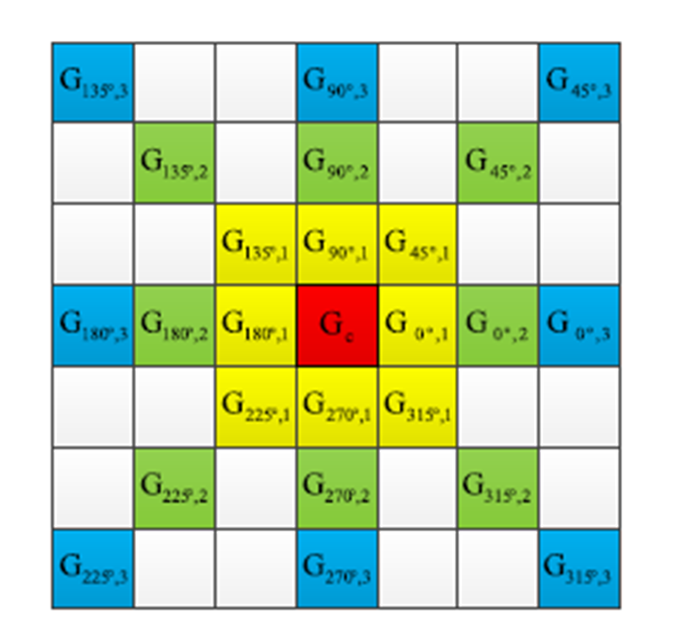
Local Vector Pattern

Slide 14
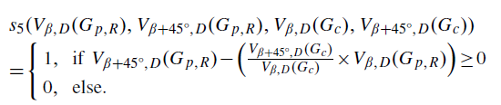

ALGORITHM FOR LVP
1-Divide the examined window into cells (e.g. 9X9 pixels for each cell).
2- For each pixel in a cell, compare the pixel to each of its 8 neighbors (on its left-top, left-middle, left-bottom, right-top, etc.), at each distance of d=1,2,3,4. Follow the pixels along a circle, i.e. clockwise or counter-clockwise.
3- Use the following formula for each cell to obtain the LVP image.
4-Repeat above steps for other images and find difference using Euclidean distance.

Slide 15
LVP

Slide 16
Confusion Matrix | A | B | Totals
A | 19 | 1 | 20
B | 1 | 29 | 30
Totals | 20 | 30 | 50

Slide 17
CONCLUSION
The algorithm uses local vector patterns to characterize faces that effectively distinguish faces of persons with different expressions. The LBP, LDerp, LVP images were used to find the feature vectors. These feature vectors are given as a input to the KNNC. The developed algorithm is evaluated under different circumstances: changing the number of faces, database with different expressions. It was observed that the best results were obtained with the LVP.
Performance analysis of LVP
True positives | False positives | False negatives | Precision | Recall | F-score
98 | 2 | 2 | 98% | 98% | 98%
Thus in this project it has been proved that the LVP is better based on the F-Score value, and any image with different expressions can be recognized. Here we have taken 100 mages with different expressions and 98 have been identified precisely, which is far better than the previous LBP and LDerP.

Slide 18


